Slide 1
Standard chemoradiotherapy with concurrent and adjuvant camrelizumab in patients phase III trial
By Chengyi and Renxiao

Slide 2
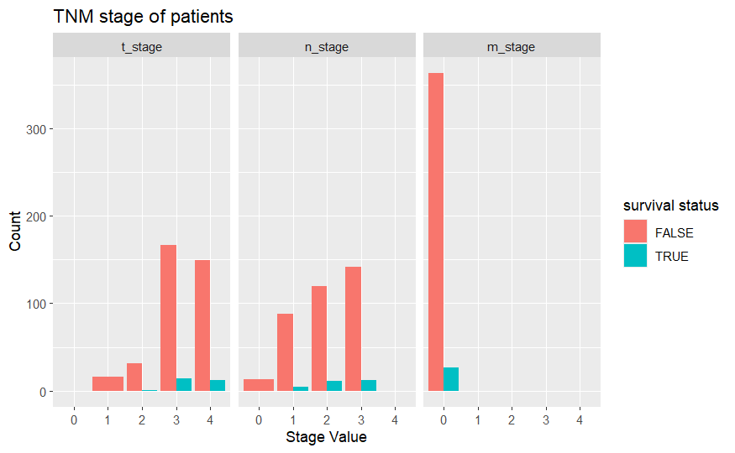
Data Exploration I

Slide 3
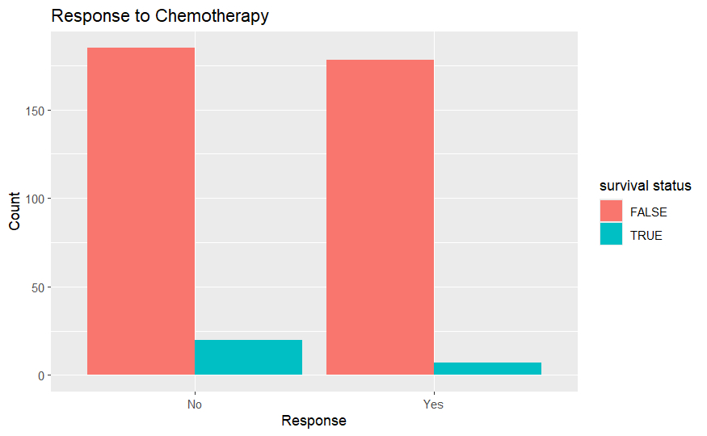
Data Exploration II

Slide 4
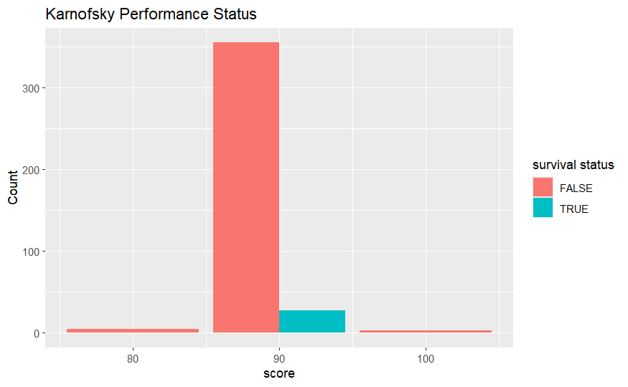
Data Exploration III

Slide 5
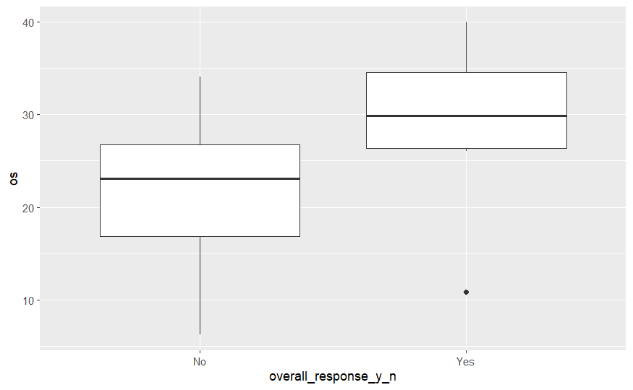
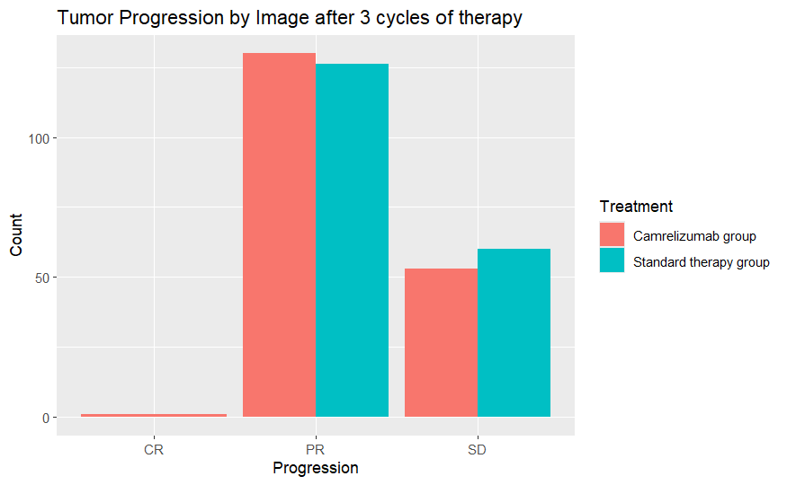
Data Analysis

Slide 6
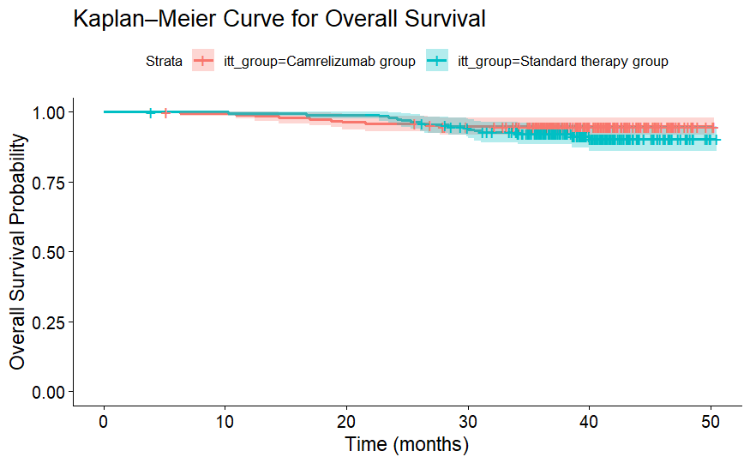
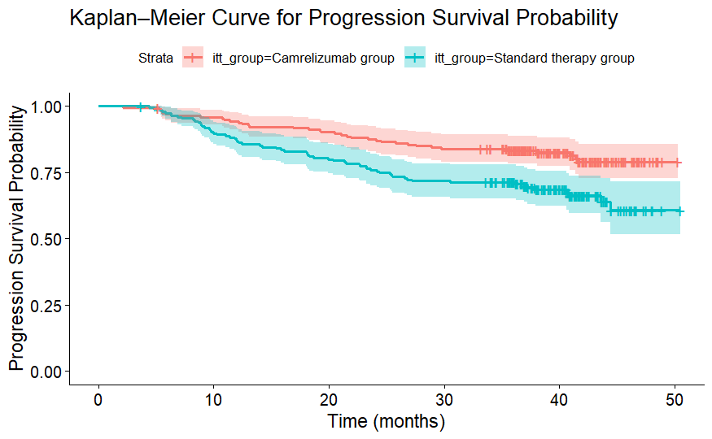
Kaplan–Meier Curves

Slide 7
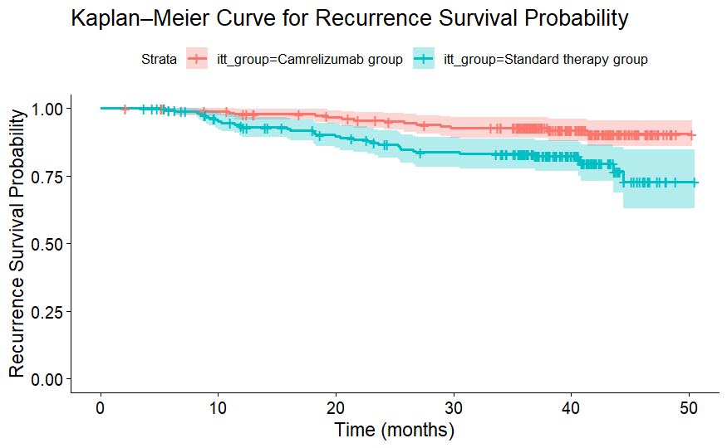
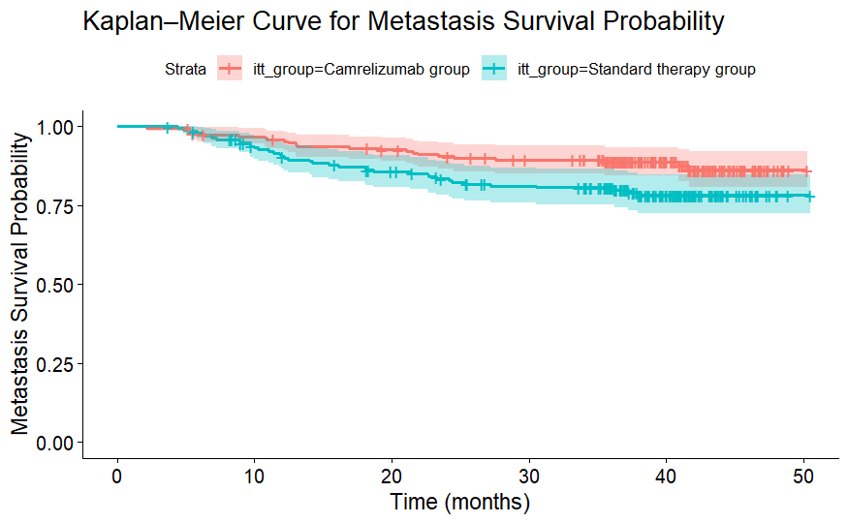
Kaplan–Meier Curves

Slide 8
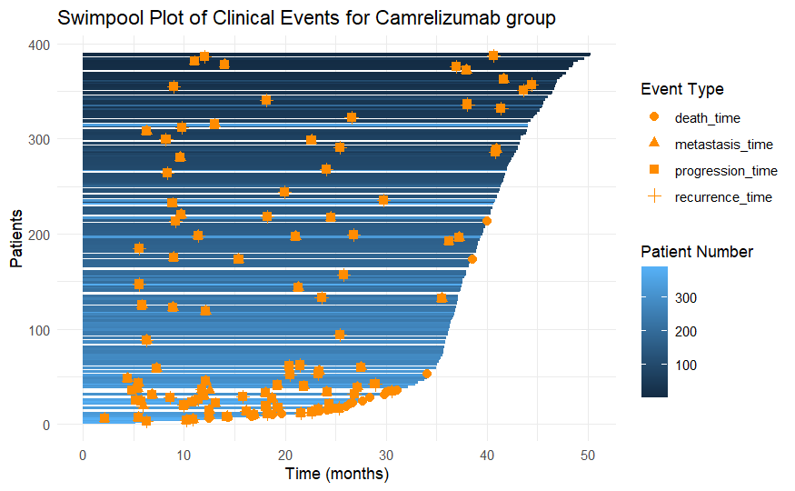
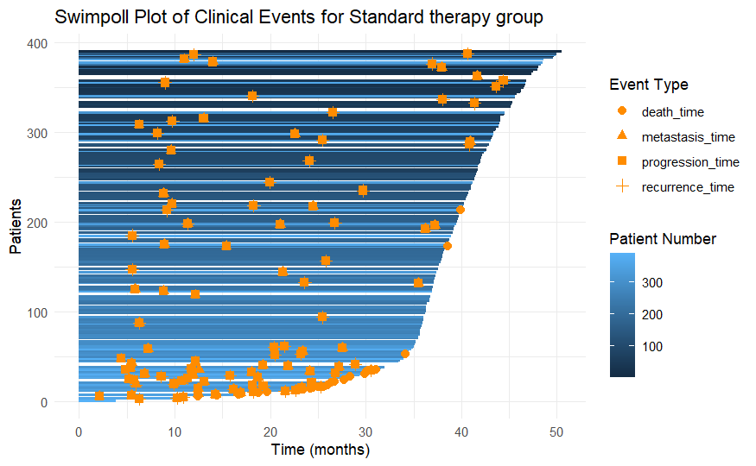
Swimpool plot

Slide 9
Other Statistics
 | Objective Response Rate | Median pfs | Duration of response
Camrelizumab group | 71.65% | 38.97 months | 38.93 months
Standard therapy group | 68.37% | 37.27 months | 37.95 months

Slide 10
Conclusion
First Line Therapy Data
Significant Improvement in recurrence and progression survival rate
Insignificant improvement in metastasis and overall survival rate
Limitation on not including measurement for tumor growth/shrink rate

Slide 11

Free templates for all your presentation needs
For PowerPoint and Google Slides
100% free for personal or commercial use
Ready to use, professional and customizable
Blow your audience away with attractive visuals

